Slide 1
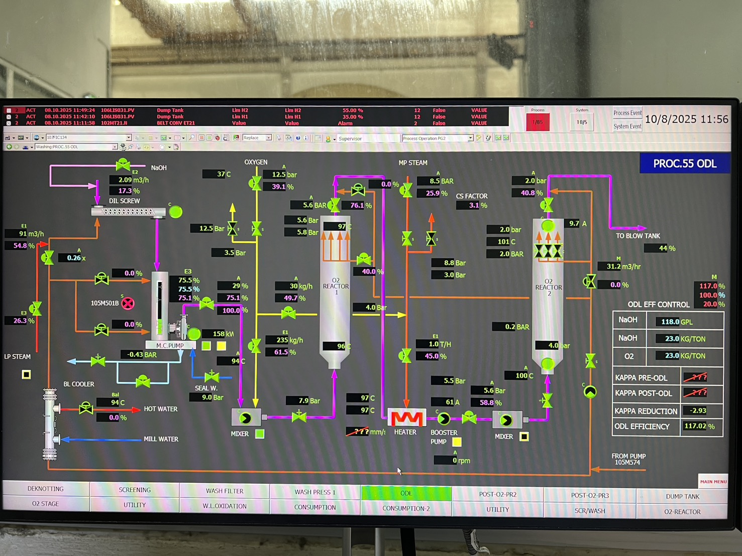
PM2.105FIC303:MV
PM2.105TI318
PM2.305PIC030:MV
PM2.305PZ024
PM2.305TI026
PM2.105PS328
PM2.305PZ025
PM2.105TI326
PM2.305PI017
PM2.305FIC022:MV
PM2.305TI028
PM2.305FIC036:MV
PM2.305FIC019:MV
PM2.105KI002
PM2.105TIC322:MV
PM2.105KI003
PM2.Prod.ODL

Slide 2
Tag | Description | Noted
\\VPKGDRBPPI01\PM2.105FIC303:MV | WHLiqu to DilSrew | White liquor
\\VPKGDRBPPI01\PM2.105KI002 | Pre O2 Kappa | Kappa online ?
\\VPKGDRBPPI01\PM2.105KI003 | Post O2 Kappa | Kappa online ?
\\VPKGDRBPPI01\PM2.105TI318 | O2-line | Temp Oxygen to ODL
\\VPKGDRBPPI01\PM2.105TIC322:MV | O2 Reactor FeedTemp | Pulp temp feed reactor 2
\\VPKGDRBPPI01\PM2.305FIC019:MV | O2 to Mixer1 | Oxygen feed at reactor 1
\\VPKGDRBPPI01\PM2.305FIC022:MV | O2 to pulp heater | Oxygen feed at reactor 2
\\VPKGDRBPPI01\PM2.305PI017 | O2 | Oxygen pressure
\\VPKGDRBPPI01\PM2.305PIC023:MV | O2 REACT PRESS.CTRL. | Pressure at reactor 1
\\VPKGDRBPPI01\PM2.305PIC030:MV | O2 reactor1 | Pressure at reactor 1
\\VPKGDRBPPI01\PM2.305PZ024 | O2 Reactor1 TOP | Pressure top reactor 1
\\VPKGDRBPPI01\PM2.305PZ025 | O2 Reactor1 TOP | Pressure top reactor 1
\\VPKGDRBPPI01\PM2.305TI026 | O2 Reactor1 TOP | Temp top reactor 1
\\VPKGDRBPPI01\PM2.305TI028 | O2 Reactor1 Bottom | Temp bottom reactor 1
\\VPKGDRBPPI01\PM2.305FIC036:MV | MP Steam Pulp Heat | Feed before reactor 2
\\VPKGDRBPPI01\PM2.Prod.ODL | Production ODL
\\VPKGDRBPPI01\PM2.105TI326 | Oxygen Reactor | Temp top reactor 2
\\VPKGDRBPPI01\PM2.105PS328 | Oxygen Reactor | Pressure top reactor 1

Slide 3
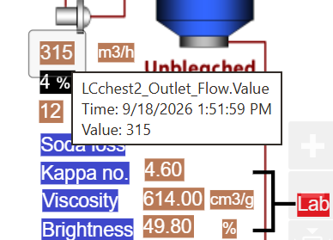
PM2.105FIC544:MV
PM2.105FIC508:MV
O2 -tank 1 : 95 m3
O2 - tank 2 : 145 m3
LC chest 1 : 110 m3
LC chest 2 : 125 m3

